Slide 1


COVID 19 Vaccine Deployment Plan for Georgia
January 16 2021

Slide 2
Content
Potential candidate vaccines and selection criteria
Organization and logistics of vaccine delivery to population groups
Required financial resources
Management of the vaccination program
Target groups and stages of coverage
Preparation: Training, Vaccine Safety Surveillance and Information Systems
Communication priorities- demand generation

Slide 3
Goal of the plan
Vaccine efficacy and natural immunity (after recovery from COVID 19) defines the level of coverage to be achieved by the country for protecting population and opening economy.
Therefore, Georgia intends to reach approximately 60% of adult population in 2021
https://www.mckinsey.com/industries/healthcare-systems-and-services/our-insights/when-will-the-covid-19-pandemic-end

Slide 4
Key assumptions
Information about vaccine trials, registration, manufacturing, distribution and supply of COVID-19 vaccines is constantly changing, therefore the VDP will be revised and adapted regularly as new information becomes available
Production capacity of three vaccines currently authorized by the WHO and/or Stringent Regulatory Authorities (SRA) is somewhat limited, therefore it is expected that the amount of vaccines supplied to Georgia in Q1 of 2021 will be small. Q1 can be devoted to preparatory work for further roll out of the vaccination program in Q2.
The amount of vaccines available for the country will increase in Q2 and subsequently in Q3.
Step-wise implementation is envisioned, to cover priority (high risk groups) at an initial stage and then extend the program to other population groups.

Slide 5
Target Population and Stages of Coverage
Stages | Priority high risk groups and ranking | Target Population * | Proportion Coverage(%) | Total number of individuals to be vaccinated**
Ia | Health Care Workers | 71,415 | 65% | 46,420
Ia | Beneficiaries and staff of long term care facilities | 2,600 | 60% | 1,560
Ia | Population over 75 years old | 226,800 | 60% | 136,080
Ib | Population 65-74 years old | 329,183 | 60% | 197,510
IIa | Providers of essential (basic) services | 180,373 | 60% | 108,224
IIa | Population 55-64 years old | 478,400 | 60% | 287,040
IIb | People with chronic disease in 18-54 age group | 89,400 | 60% | 53,640
Total (High risk and essential groups) |  |  |  | 830,474
III | Other population groups | 1,434,567 | 60% | 860,740
Total |  |  |  | 1,691,214
% of adult population |  |  |  | 60%
In order to meet the above targets, the country will need approximately 3,979,300 doses ( Considering anticipated vaccine waste factors)
* Sizes for some target groups are estimated. Group are not mutually exclusive therefore the size estimates have been adjusted
** Given that all currently available vaccines are intended to adult population, calculations and coverage rate is provided for 18+ age groups

Slide 6
Candidate vaccines for the NVDP
The Plan is flexible in terms of selecting vaccines having different cold chain requirements with the following assumptions:
Vaccines that require - 80⁰C temperature will be secured for the first priority and other organized groups in the volume of up to 200,000 doses
Or
Vaccines that require - 200C temperature will be secured for the first priority and other organized groups in the amount of up to 200,000 doses (however it is possible to double the doses if required)
  AND
  Predominantly the vaccines requiring 2-8⁰C temperature will be used for most part of target population. Georgia’s national immunization system well accustomed to this type of vaccines.
Above assumptions are based on the following global vaccine market information:
  Most of the potential vaccine suppliers are expected to produce vaccines with 2⁰C - 8⁰C cold chain requirements, apart of two exceptions that require -80⁰C and -20⁰C regimens
  In Q1 of 2021 the volume of vaccines with emergency use authorization will not exceed 1.5-2.7 billion doses. Further increase in production capacity is expected in Q2 of 2021 with approximately 3.6 billion doses to be produced. And in most part these vaccines will require 2⁰C - 8⁰C temperature regimen.
  Most of vaccines order by the COVAX facility are those that require 2⁰C - 8⁰C temperature regimens.
* https://www.unicef.org/supply/covid-19-vaccine-market-dashboard

Slide 7
Selection criteria for candidate vaccines
In line with the Georgian legislation the candidate vaccine should meet the following requirements¹
  The vaccine should be on WHO Emergency Use Listing or should have WHO prequalification
  OR
  Vaccine should have emergency use authorization issued by a WHO designated Stringent Regulatory Authority (SRA). For instance, FDA (US), EMA (European Union), United Kingdom, Japan, Australia (37 Regulatory authorities in total)
As of January 2021, there are three vaccines meeting the above criteria. It is foreseen that this list will be extended substantially in Q2 and Q3 of 2021.
¹Georgian Law on Drugs and Pharmaceuticals

Slide 8


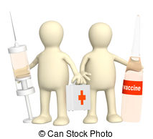
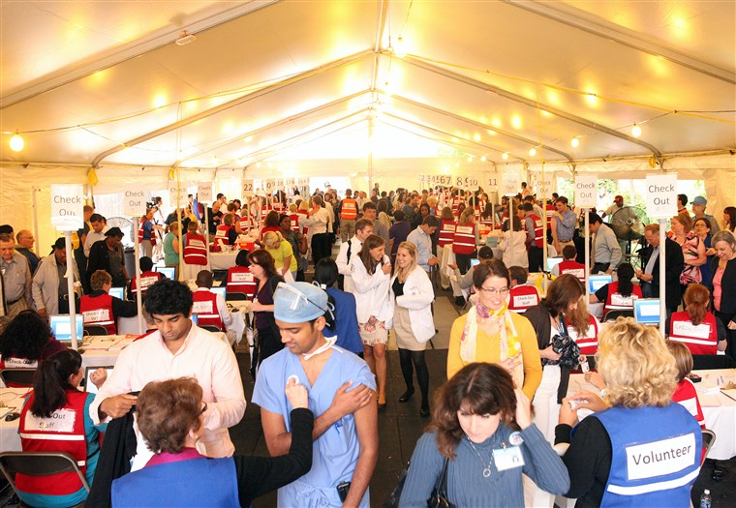
Selection of health facilities for immunization program
Immunizations services will be delivered at the following establishments to cover 60% of the target population within a limited time period
Hospitals
To vaccinate it own medical personnel
To vaccinate priority groups
Vaccines requiring - 80⁰C cold chain will be administered in selected hospitals only
Clinics currently delivering immunization services
To vaccinate its own medical personnel and personnel of assigned medical establishments in the neighborhood (i.e. staff of dental, cosmetic and other clinics)
To vaccinate priority and general population groups
Mobile teams
Beneficiaries and staff of long-term care facilities
Home bound patients with limited mobility
Massive vaccination centers in big cities (needs establishment)
To vaccinate priority population groups
To vaccinate general public

Slide 9
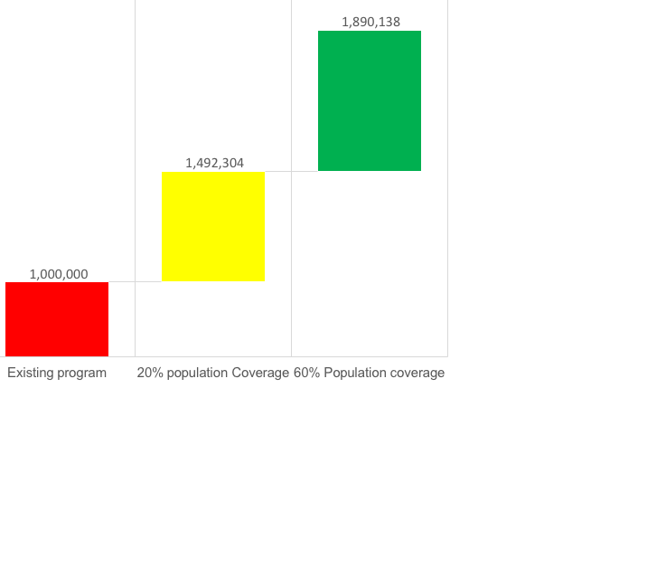
Organization and logistics of vaccine delivery to population groups
60% coverage of adult population would be necessary for achieving immunity and opening economy
This would mean fourfold increase in immunization capacity
While existing capacity would be capable to handle the vaccine load
Current capacity of the facilities involved in the program would not be sufficient to handle this workload unless the following is undertaken:
  Special intersectoral group is established to manage the campaign
  Number of health facilities delivering immunization services increase
  Mobile teams established to further expand the reach of existing facilities
  Mass vaccination clinics are established in big cities

Slide 10
Stages of immunization roll out, expected load* and Needed capacity **
*calculations are based on 6 working days week
** calculations are preliminary and should be adjusted
*** Division of the workload between mobile and on site teams not indicated

Slide 11
Human resources management and training
  Human resources for the vaccination program will be trained based on manuals and guidelines elaborated by the WHO and other relevant organizations
  Training plan, thematic areas and training methodology have already been elaborated
  The target audiences have been defined
  It is planned to initiate online training

Slide 12
Vaccine Safety Surveillance
The monitoring of Adverse Events Following Immunization (AEFIs) will be carried out with the existing system that has been operational under the State Immunization Program for over two decades.
The last update issued in 2019 will be modified to integrated specific requirements related to COVID-19 vaccination.
The system and related manuals/forms will be updated to reflect elements specific to selected vaccine(s). In addition, new regulations will be elaborated and put in place as needed
The National Immunization Safety Surveillance Council will be expanded and will include new members to monitor adult population that is the main target for the COVID 19 vaccination program

Slide 13
Information system, monitoring and surveillance
  A vaccination program registration module will be developed for COVID19 vaccine visit booking
  Vaccination registration and reporting will be carried out through the existing electronic immunization management module. (has been used since 2013). Additional functions will be added for generating reminders for the second shot and monitor compliance of the target groups
  Vaccine Stock management electronic module will be adjusted for the new vaccines for effective management of vaccine supplies
  With minor adjustments the existing electronic system will provide vaccine logistics monitoring; immunization service monitoring; will track vaccine coverage; will compare actual coverage with targets and will produce the needed reports
  Epid surveillance will be conducted via unified electronic system that has been used for disease surveillance purposes in the country, including for COVID19 during 2020

Slide 14
Communication Priorities- Demand Generation
Two main communication challenges:
  Recent survey data conducted in December 2020 (NCDC 2020) indicates that 22% of the population are not willing and 19% are hesitant to be vaccinated
  Managing expectations of individuals which are ready to be vaccinated but do not belong to priority groups
A comprehensive and proactive communication strategy has been elaborated and costed for immediate short-term activities. The plan envisions
  Training for health care workers and media
  Information and social mobilization campaigns at a national level
  Crisis management plan ( in response to anticipated adverse reactions and other challenges)
  Public hearings, media and social monitoring and to counter disinformation narratives

Slide 15
Required financial resources
(preliminary estimates)
Budget item | Lowest cost in GEL | Highest Cost in GEL
Vaccine Procurement | 48,456,260 | 141,985,429
Syringes and other supplies | 4,960,082 | 5,087,534
Service delivery | 8,834,300 | 9,034,300
Training | 34,900 | 34,900
Vaccine logistics and distribution | 164,085 | 164,085
Information systems | 167,695 | 167,695
Monitoring and supervision of vaccination program | 53,500 | 53,500
Communication and demand generation | 1,662,800 | 1,662,800
Total Budget | 64,333,622 | 158,190,243
Notes:
Calculations consider introduction of various vaccines at an initial stage of the vaccination program,
Budget does not cover costs related to establishment of mass vaccination centers and operational costs. These costs will be calculated at a later stage
Neither establishment nor operational costs of the intersectoral management group is included in the above calculations
Exchange rate applied 1USD = 3.3GEL

Slide 16
Organizational Arrangements for Managing the Vaccination Program

Slide 17
Existing Preconditions for NVDP
NVPD has been developed with necessary legal and regulatory documents
Georgia is registered on COVAX platform, has made prepayment for 1.4 mln doses, necessary to cover 20% of population.
Country has well functioning immunization systems with adequate cold-chain capacity
Immunization is a recognized national priority: over past 8 years national funding for the program increased six-fold. Country only purchases WHO pre-qualified vaccines for assuring quality supply.
Over recent years and with support from GAVI Alliance, country introduced four new vaccines. Therefore, immunization service providers have undergone extensive trainings several times.
Country and immunization program have well established partnerships with (WHO, UNICEF, GAVI, COVAX, WB, USAID, ADB, etc.)

